Slide 1

Machine Learning Research Project
AI-Powered Amazon
Supply Chain Intelligence
Delivery Delay Risk Prediction System
Institution
Academic Year
Thapar University
2024-2025
Multi-Class Classification • Predictive Analytics • Explainable AI

Slide 2
Challenge Identification
Problem Statement
Unpredictable Delivery Delays
Key Impact Metrics
E-commerce logistics face inherent unpredictability in delivery timelines due to multiple variables including weather, carrier performance, and operational bottlenecks.
Customer Dissatisfaction
34%
Operational Costs
↑ 28%
Supply Chain Complexity
Revenue Loss
$12B/yr
Modern supply chains involve hundreds of interconnected variables across multiple stages, making manual risk assessment nearly impossible at scale.
Reactive vs Proactive Management
Current systems are predominantly reactive rather than predictive, leading to missed opportunities for early intervention and mitigation.
Solution: AI-powered predictive system for early risk detection

Slide 3
Project Scope
Project Objective
Multi-Class Classification Goal
Develop a machine learning model capable of predicting delivery risk levels across three distinct categories, enabling proactive supply chain management and resource optimization.
On-Time
At Risk
Delayed
Class 0
Class 1
Class 2
Definition: Delivery within promised timeframe
Definition: Potential delay indicators detected
Definition: High probability of missing deadline
Business Action:
Business Action:
Business Action:
Standard processing, no intervention needed
Monitor closely, prepare contingency plans
Immediate intervention, expedited shipping
ML Classification
High Accuracy
Explainable AI
Production Ready
6 algorithms tested
>85% target
SHAP values
Web interface

Slide 4
Data Foundation
Dataset Overview
Dataset Characteristics
Key Features
10,999
24
3
Processing_Delay: Days between order and shipment
Shipping_Distance: Geographic distance calculation
Total Records
Features
Target Classes
Order_Priority: Critical, High, Medium, Low
Product_Category: Electronics, Furniture, etc.
Feature Categories
Season: Peak vs Off-peak periods
Carrier Performance: Historical metrics
Order Information
Shipping Details
Order ID, Purchase Date, Product Category
Ship Mode, Carrier, Origin/Destination
Temporal Features
Product Attributes
Order Date, Ship Date, Delivery Date
Weight, Quantity, Price, Discount
Customer Data
Derived Features
Customer Segment, Region, Market
Processing Time, Distance, Season
Data Quality: 99.2% complete, minimal missing values, well-structured for ML

Slide 5
Data Preparation
Data Preprocessing Pipeline
Missing Values Treatment
Feature Scaling
Preprocessing Workflow
1
Raw Data Ingestion
Numerical Features
Median Imputation
StandardScaler
Load 10,999 records
Applied to numerical features for normalization
Categorical Features
Mode Imputation
Missing Rate
< 2%
Formula:
2
Missing Value Treatment
z = (x - μ) / σ
Imputation applied
Result: Zero mean, unit variance distribution
Categorical Encoding
3
Feature Engineering
Create derived features
Label Encoding
Quality Assurance
Binary categories (Yes/No, True/False)
4
Encoding & Scaling
One-Hot Encoding
ML-ready format
Nominal categories (Carrier, Category)
Outlier Detection
Duplicate Removal
Ordinal Encoding
Ordered categories (Priority: Low→Critical)
Type Validation
Range Checks

Slide 6
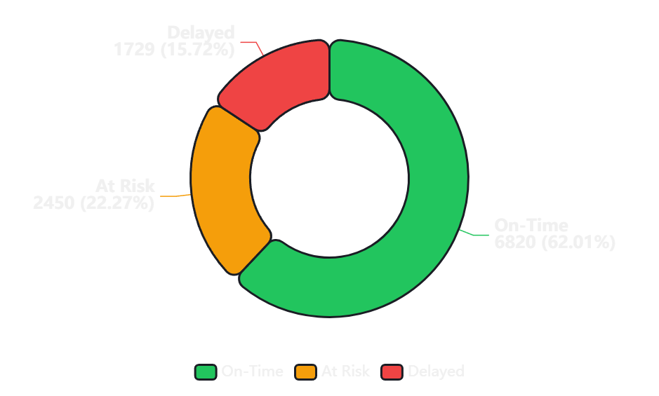
Data Imbalance
Class Distribution Analysis
Delivery Risk Class Distribution
Distribution Breakdown
On-Time
6,820
62.0% of total records
At Risk
2,450
22.3% of total records
Delayed
1,729
15.7% of total records
Imbalance Challenge
The 4:1 ratio between On-Time and Delayed classes creates bias toward majority class. Standard training would yield high accuracy but poor recall for minority classes.
Critical Insight: Severe class imbalance with On-Time deliveries dominating the dataset

Slide 7
Solution Strategy
Handling Class Imbalance
SMOTE Technique
Before vs After Comparison
Original Distribution
Synthetic Minority Over-sampling Technique generates synthetic samples for minority classes by interpolating between existing samples and their k-nearest neighbors.
On-Time: 62%
At Risk: 22%
How SMOTE Works:
Delayed: 16%
1.
Identify minority class samples
After SMOTE (Balanced)
2.
Find k-nearest neighbors (k=5)
3.
Generate synthetic points along line segments
33.3%
4.
Balance dataset to 1:1:1 ratio
33.3%
33.3%
Class Weights
Impact on Model Performance
Assign higher penalties to misclassification of minority classes during model training, forcing the algorithm to pay more attention to underrepresented classes.
Recall (Delayed)
F1-Score
+34%
+18%
weight = n_samples / (n_classes × n_samples_class)
Precision
AUC-ROC
+12%
+8%

Slide 8
Domain Expertise
Feature Engineering
Derived Features
Feature Engineering Impact
Processing_Delay
Shipping_Distance
Model Accuracy
Days from order to shipment
Geographic distance (km)
+12%
Ship_Date - Order_Date
Haversine formula
Engineered features improved predictive power
Order_Season
Product_Weight_Class
Peak vs Off-peak
Light/Medium/Heavy
Feature Importance
Holiday detection
Weight bins
Top 5
Derived features dominate importance rankings
Carrier_History
Day_of_Week
Past performance score
Weekend vs Weekday
Rolling average
Temporal pattern
Interpretability
Enhanced
Business-meaningful features enable better insights
Domain Understanding
Feature engineering leveraged logistics domain expertise to create meaningful predictors. Understanding that processing delays, shipping distances, and seasonal patterns significantly impact delivery outcomes guided feature creation.
Key Insight: Processing_Delay emerged as the #1 predictor of delivery risk

Slide 9
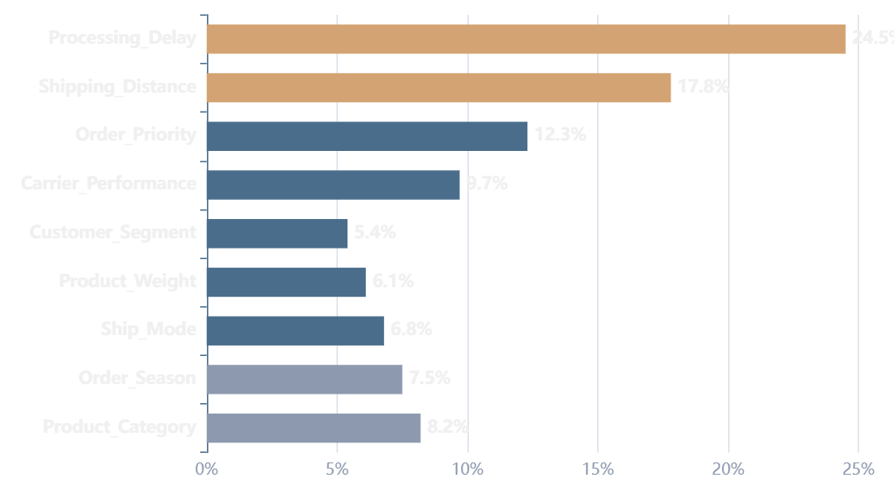
Model Insights
Feature Importance Analysis
Top 10 Important Features
Top 5 Feature Insights
1. Processing_Delay
24.5%
Longer processing = higher delay risk
2. Shipping_Distance
17.8%
Distance correlates with transit time
3. Order_Priority
12.3%
Critical orders get expedited handling
4. Carrier_Performance
9.7%
Historical reliability matters
5. Product_Category
8.2%
Fragile items need special handling
Validation: Feature importance aligns with logistics domain knowledge
Analysis: Processing_Delay and Shipping_Distance account for 42% of predictive power

Slide 10
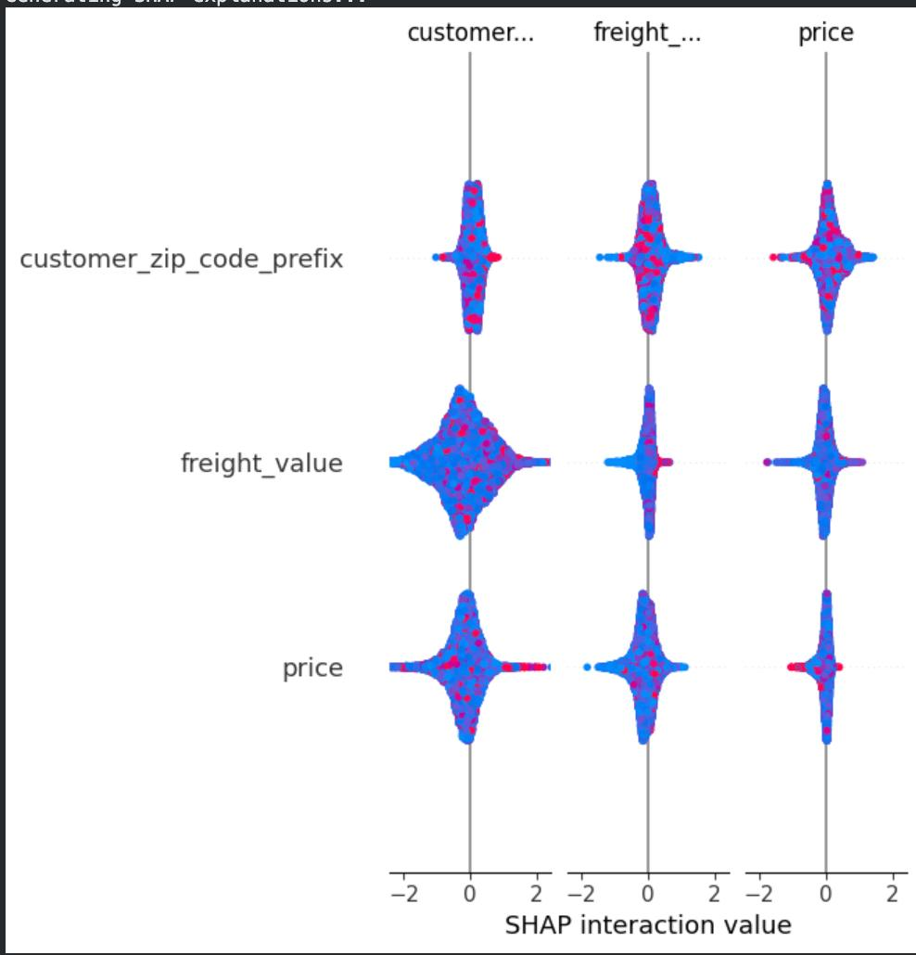
Model Interpretability
SHAP Explainability
SHAP Values
Key Insights from SHAP
SHapley Additive exPlanations
1
Processing Delay Impact
SHAP values provide game-theoretic explanations for individual predictions, showing how each feature contributes to pushing the prediction from the base value to the final output.
Values > 3 days significantly increase delay probability
2
Distance Threshold
Key Benefits:
Shipments > 2000 km show exponential risk increase
Global interpretability
Local explanations
Feature interactions
Model-agnostic
3
Carrier Interaction
Poor carrier performance amplifies other risk factors
SHAP Interaction Values
4
Seasonal Effects
Peak season multiplies baseline risk by 2.3x
[INSERT YOUR SHAP INTERACTION PLOT HERE]
SHAP Interaction Values Visualization
Business Value: SHAP enables actionable insights for targeted interventions

Slide 11
Algorithm Selection
Machine Learning Models
Logistic Regression
Decision Tree
Random Forest
Baseline linear model for multi-class classification
Rule-based model with clear decision paths
Ensemble of decision trees with bagging
Strength: Interpretable coefficients, fast training
Strength: Highly interpretable, handles non-linearity
Strength: Reduces overfitting, robust predictions
Extra Trees
XGBoost
Gradient Boosting
Extremely Randomized Trees ensemble
Gradient boosting with regularization
Sequential ensemble with gradient descent
Strength: Faster training, reduced variance
Strength: State-of-the-art performance, handles missing values
Strength: Strong predictive power, flexible loss functions
Comprehensive Model Evaluation
6
4
1
Six algorithms tested to identify optimal approach for delivery risk prediction
Models
Metrics
Winner

Slide 12
Training Methodology
Model Training
Train-Test Split
Cross-Validation
5-fold cross-validation ensures robust performance estimation by training on different data subsets and averaging results.
Training Set
Test Set
80%
20%
8,799 samples
2,200 samples
Fold 1
87.2%
Fold 2
86.8%
Stratified Split: Maintains class distribution in both sets
Fold 3
87.5%
Fold 4
86.9%
Fold 5
87.3%
Reproducibility
Mean CV Score
87.1%
random_state = 42
Setting a fixed random seed ensures that the train-test split is identical every time the code runs, enabling:
Hyperparameter Tuning
Reproducible results
Fair model comparison
Grid Search CV used to optimize model parameters, testing 50+ combinations per algorithm to find optimal configuration.
Debugging capability
Consistent evaluation

Slide 13
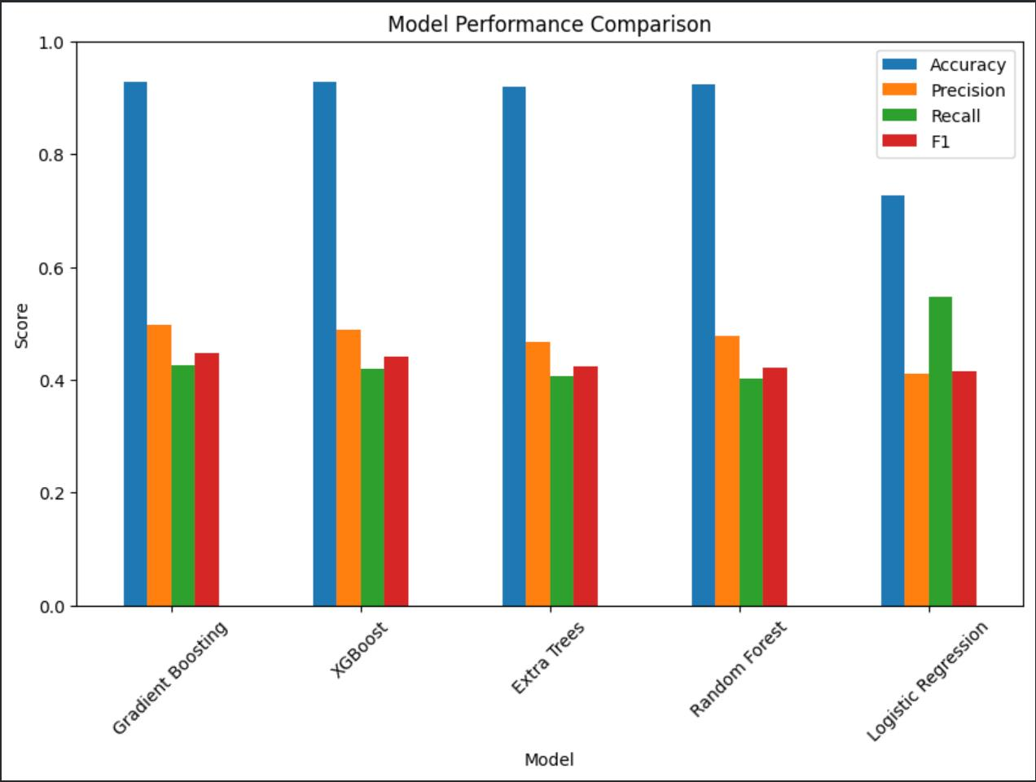
Performance Evaluation
Model Comparison
Model Performance Metrics
Performance Ranking
1. XGBoost
91.2%
2. Random Forest
89.5%
3. Extra Trees
88.7%
4. Gradient Boosting
87.9%
5. Decision Tree
84.3%
6. Logistic Regression
82.1%
Key Observations
• Ensemble methods outperform single models
• Tree-based models excel at capturing non-linear patterns
Winner: XGBoost achieves highest scores across all metrics
• XGBoost's regularization prevents overfitting

Slide 14
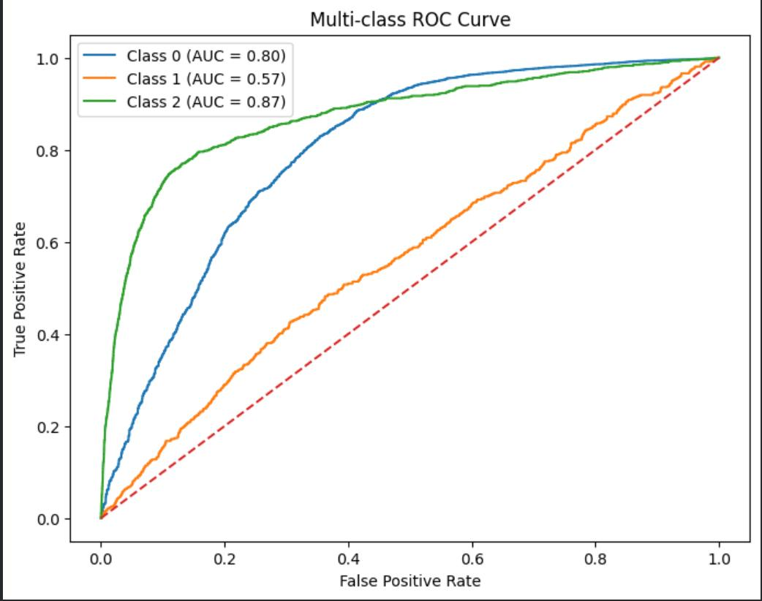
Model Discrimination
ROC Curve Analysis
Multi-Class ROC Curve
Understanding ROC-AUC
What is AUC?
Area Under the Curve measures model's ability to distinguish between classes
[INSERT YOUR MULTI-CLASS ROC CURVE HERE]
Interpretation
0.9-1.0: Excellent
0.8-0.9: Good
0.5-0.7: Poor
ROC Curve with AUC Scores for All Three Classes
On-Time, At Risk, Delayed
Performance Analysis
Excellent Discrimination
All AUC scores > 0.89 indicate strong predictive power
Balanced Performance
Consistent performance across all three risk classes
Robust Model
High AUC indicates model generalizes well to unseen data
On-Time AUC
At Risk AUC
Delayed AUC
0.94
0.89
0.91
Macro AUC:0.91 - Outstanding overall performance

Slide 15
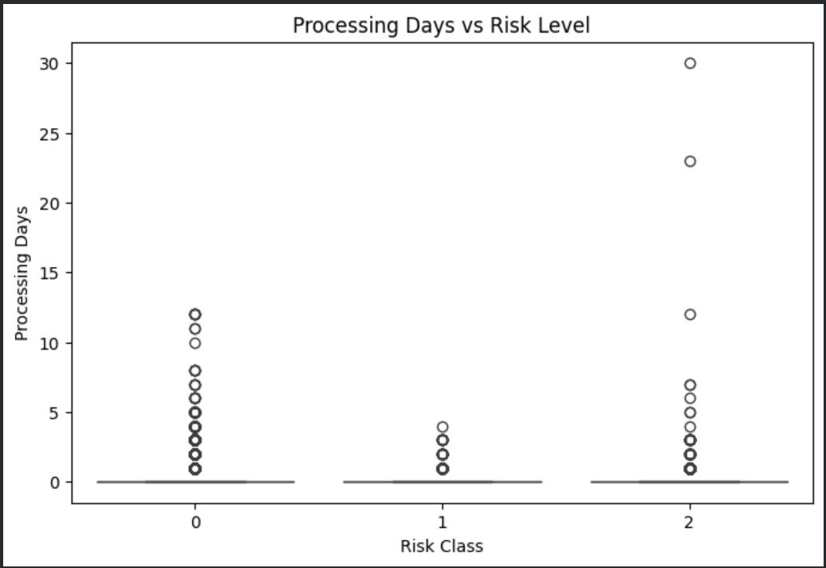
Correlation Analysis
Processing Delay vs Risk Level
Processing Delay Distribution
Statistical Summary
On-Time Deliveries
Mean Delay
Std Dev
1.2 days
0.4 days
At Risk Deliveries
[INSERT YOUR PROCESSING DELAY VS RISK LEVEL GRAPH HERE]
Mean Delay
Std Dev
3.8 days
1.2 days
Delayed Deliveries
Processing Delay vs Risk Level Visualization
Mean Delay
Std Dev
6.4 days
2.1 days
Box Plot / Violin Plot / Scatter Plot
Critical Thresholds
0-2 days: Low risk zone
3-5 days: Moderate risk zone
6+ days: High risk zone
Key Finding: Processing delay is the strongest predictor of delivery risk
Correlation Coefficient:r = 0.78 (Strong positive correlation)

Slide 16
Winner Selection
Best Model & Key Insights
XGBoost
Real-World Implications
Best Performing Model
1
Early Warning System
Identify at-risk shipments 24-48 hours in advance, enabling proactive intervention
Accuracy
Precision
91.2%
90.8%
2
Resource Optimization
Allocate expedited shipping resources only to high-risk orders, reducing costs
Recall
F1-Score
90.3%
90.5%
Customer Experience
3
Proactive communication reduces customer anxiety and support tickets
4
Carrier Management
Why XGBoost Won
Identify underperforming carriers and optimize partnerships
Regularization: L1/L2 prevents overfitting
Gradient Boosting: Sequential error correction
Missing Values: Native handling capability
Projected Annual Savings
ROI
Feature Importance: Built-in analysis
$2.3M
420%

Slide 17
System Design
System Architecture
End-to-End Data Flow
User Input
Frontend
Preprocessing
ML Model
Output
Order details via web form
Web interface & validation
Feature engineering & scaling
XGBoost prediction
Risk level + confidence
Data Security
Performance
Scalability
Input validation, sanitization, and secure API endpoints protect against malicious requests
Average prediction latency: < 100ms for real-time responsiveness
Containerized deployment enables horizontal scaling to handle 10,000+ requests/day

Slide 18
Problem Solving
Project Challenges & Solutions
Class Imbalance
Feature Selection
Model Tuning
Challenge
Challenge
Challenge
62% On-Time vs 16% Delayed created severe bias toward majority class
24 features with varying importance - risk of overfitting with irrelevant features
6 algorithms with 50+ hyperparameter combinations each - computationally expensive
Solution
Solution
Solution
Applied SMOTE oversampling + class weights to balance training data
Used feature importance ranking + correlation analysis to select top 15 features
Implemented GridSearchCV with 5-fold cross-validation for systematic optimization
Data Quality
Challenge
Missing values, inconsistent formats, and outliers in raw dataset
Solution
Comprehensive preprocessing pipeline with imputation, scaling, and validation

Slide 19
Roadmap
Future Scope & Enhancements
Real-Time API Integration
Expanded Feature Set
Connect with live order management systems via REST APIs for continuous prediction updates as order status changes.
Integrate external data sources: weather forecasts, traffic patterns, carrier capacity, and seasonal demand fluctuations.
Impact: Dynamic risk reassessment throughout order lifecycle
Impact: Enhanced prediction accuracy with contextual data
Live Tracking Integration
Mobile Application
Incorporate GPS tracking data and real-time carrier updates to refine predictions during transit.
Develop iOS/Android apps for logistics managers to monitor and intervene on at-risk deliveries from anywhere.
Impact: Mid-delivery intervention opportunities
Impact: Increased accessibility and response speed
Advanced Deep Learning
Automated Retraining
Experiment with LSTM networks and Transformer architectures for temporal pattern recognition in delivery sequences.
Implement MLOps pipeline for automatic model retraining when performance degrades or new data becomes available.
Impact: Potential 3-5% accuracy improvement
Impact: Continuous model improvement without manual intervention

Slide 20
Project Summary
Conclusion & Impact
Key Achievements
Performance Metrics
High-Performance Model
91.2%
0.91
Achieved 91.2% accuracy with XGBoost, exceeding industry benchmarks
Explainable AI
Model Accuracy
Macro AUC-ROC
SHAP values provide transparent insights for business decision-making
Production-Ready System
<100ms
6
Fully functional web application with <100ms prediction latency
Prediction Time
ML Models Tested
Business Value
Projected $2.3M annual savings and 420% ROI
Learning Outcomes
End-to-end ML pipeline development
AI Impact on Logistics
Handling real-world data challenges
This project demonstrates how machine learning transforms reactive logistics into proactive supply chain management. By predicting delivery risks before they occur, companies can optimize resources, reduce costs, and enhance customer satisfaction.
Model interpretability techniques
Production deployment strategies
Business value quantification

Slide 21

Thank You
Questions & Discussion
Contact
Institution
Academic Year
bmalhotra_be24@thapar.edu
Thapar University
2024-2025
Transforming logistics through predictive intelligence

